Slide 1
Traveling Tips & Tricks
How to get the best deals in travel

Slide 2
Presentation Notes and Resources
LeChicGeek.com/librarytalk

Slide 3
Flexibility is key!

Slide 4
Know your personal goals
Only you know what type of trip you want to take.
Don’t listen to things you have to do or places you have to go to.

Slide 5
Figure out what is Most important to you
I want to go to X location
I want to travel on X dates
I want to take the best trip I can at the cheapest rate possible

Slide 6
What this doesn’t mean
This doesn’t mean you can’t end up on a cheap trip to your dream destination.
What it does mean is prioritizing what is important to you so you don’t make travel decisions for the wrong reasons.
Remember: you can plan out multiple trips!

Slide 7
Choosing based on the destination
Google Flights
Google.com/flights
Airfare Watchdog
AirfareWatchdog.com

Slide 8
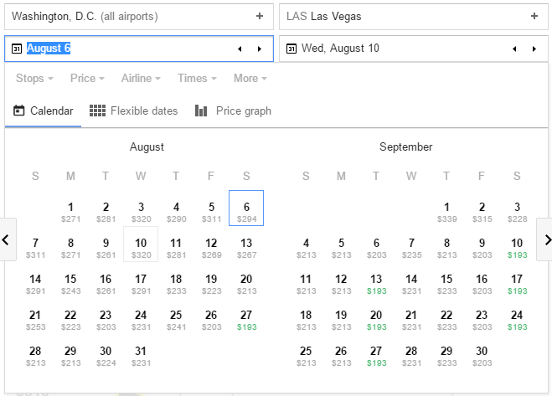
Google Flights

Slide 9
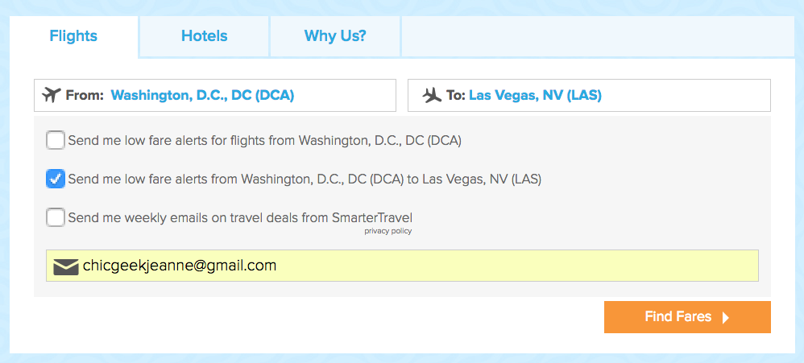
Airfare WAtchdog

Slide 10
Choosing based on the dates
Google Flights
Google.com/flights

Slide 11
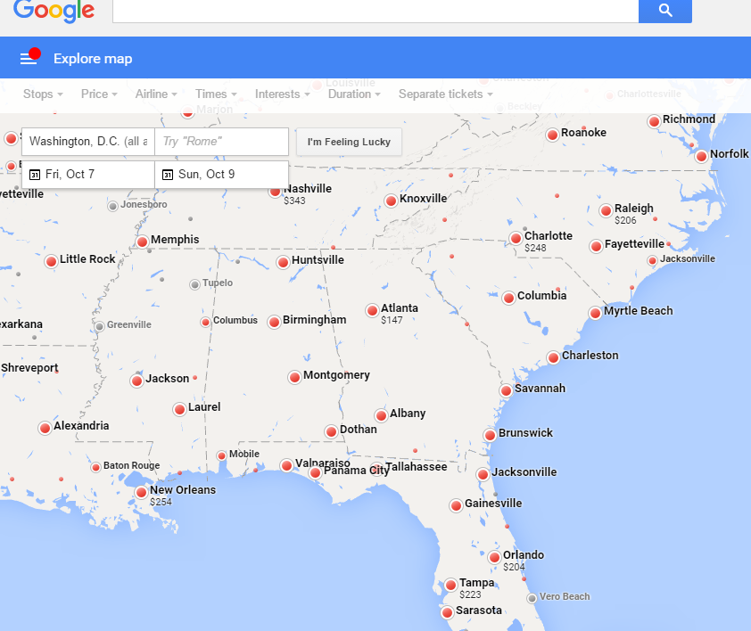
Google Flights

Slide 12
Choosing based on the cheapest
The Flight Deal
TheFlightDeal.com

Slide 13
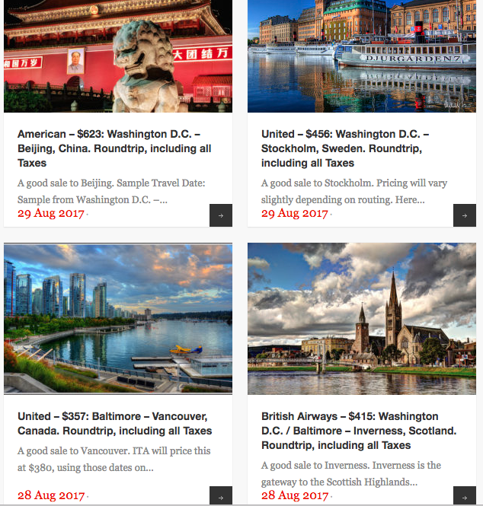

Slide 14
Tips For BOoking
Deals don’t last!
Know airline cancellation and hold policies

Slide 15
What about other deals? Resorts… etc.
Read the fine print!
Are there specific dates you need to travel?
Is there a specific airline you need to fly?
Does the deal expire at some point?

Slide 16
Package Sites I trust
Expedia.com/Travelocity.com
CheapCaribbean.com

Slide 17
Low-cost Carriers
Spirit Airlines
Fees
Fees
Fees
LeChicGeek.com/spirit
Spirit Airlines cheat sheet

Slide 18
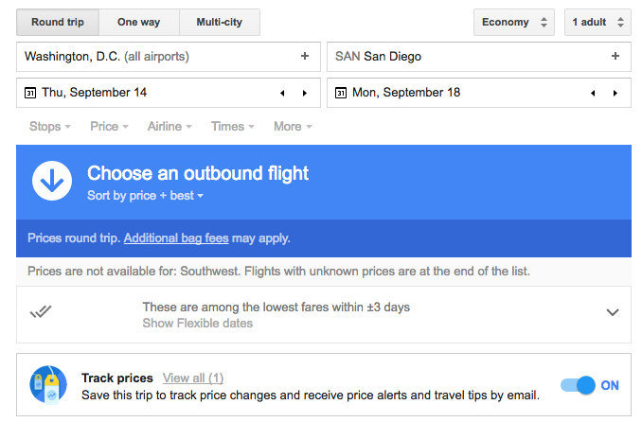
What if a flight is too expensive?

Slide 19
Contact me
LeChicGeek.com
LeChicGeek.com/librarytalk
ChicGeekJeanne@gmail.com
@Jeanne23 on Twitter

